Slide 1
@Enableautoconfig
Ida Amit

Slide 2
Agenda
Starters
debugging
excluding
3
2
@SpringBootApplication
@Configuration @ComponentScan
@EnableAutoConfiguration
@Component
1
What is an annotation ?

Slide 3
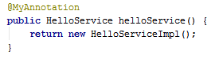
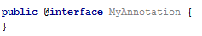
What is annotation ?
Annotations can be applied to :
Package
Class
Method
Field
Ect.
Annotation is a metadata that indicates that the declared element should be processed in some special way by a compiler (@SuppressWarnings), development tool (@Deprecated), deployment tool, or during runtime (@Transactional).

Slide 4
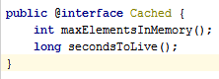
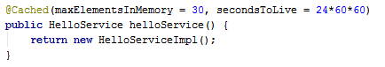
Annotation & parameters
Annotation can have parameters

Slide 5
Target of annotation
@Target(ElementType.TYPE)
@NoArgsConstructor (lombok)
@Target(ElementType.FIELD)
@NonNull (lombok)
@Target(ElementType.METHOD) – Applied on a method
@Override (predefined in the Java)
@Target(ElementType.PARAMETER) – Applied on parameter of a method
@Target(ElementType.CONSTRUCTOR)
@Target(ElementType.LOCAL_VARIABLE)
@Target(ElementType.ANNOTATION_TYPE) – Applied on annotation (@Repeatable)

Slide 6
Retention Policy of annotation
@Retention(RetentionPolicy.SOURCE)
Retained only in the source level and is ignored by the compiler
@NoArgsConstructor
@Retention(RetentionPolicy.RUNTIME)
The annotation is used at runtime
The most powerful retention policy
@Transactional
@Retention(RetentionPolicy.CLASS)
Retained by the compiler at compile time, but is ignored by the Java Virtual Machine (JVM)
The annotation will be part of the bytecode but is not needed by the JVM
The most useless retention policy, like a comment.

Slide 7
What @SpringBootApplication annotation composed of:
@Configuration
@ComponentScan
@EnableAutoConfiguration
@Documented - Indicates that whenever the specified annotation is used those elements should be documented using the Javadoc tool. To ensure that classes using your annotation show this in their generated JavaDoc.

Slide 8
@Configuration
Beans are defined in class annotated by @Configuration.
The @Import annotation can be used to import additional configuration classes.

Slide 9
@ComponentScan
Scans for Spring components (like @Component @Service, including @Configuration)
If we do not provide a path the current location and down.
Not best practice to scan “com.demo” (slow startup)

Slide 10
@EnableAutoConfiguration
Searches for Spring configuration beans, using the SpringFactoriesLoader mechanism.
Searches for META-INF/spring.factories within your classpath jars. The configuration classes should have the key org.springframework.boot.autoconfigure.EnableAutoConfiguration
Recommended that you place @EnableAutoConfiguration in a root package (main) so that all sub-packages and classes can be searched.
Attempting to guess and configure beans based on the jar dependencies.
For example, if HSQLDB is on your classpath, and you have not manually configured any database connection beans, then Spring Boot auto-configures an in-memory database.
Auto-configuration is always applied after user-defined beans have been registered.
Make sure that auto-configuration classes defined in a specific package space and that, in particular, they are never the target of component scanning.

Slide 11
Conditional configuration
The @ConditionalOnClass and @ConditionalOnMissingClass annotations let configuration be included based on the presence or absence of specific classes.
The @ConditionalOnBean and @ConditionalOnMissingBean annotations let a bean be included based on the presence or absence of specific beans.
The @ConditionalOnProperty annotation lets configuration be included based on a Spring Environment property.
Notes:
Create class HelloServiceImpl2
@Bean public HelloService helloService() { return new HelloServiceImpl2(); }

Slide 12
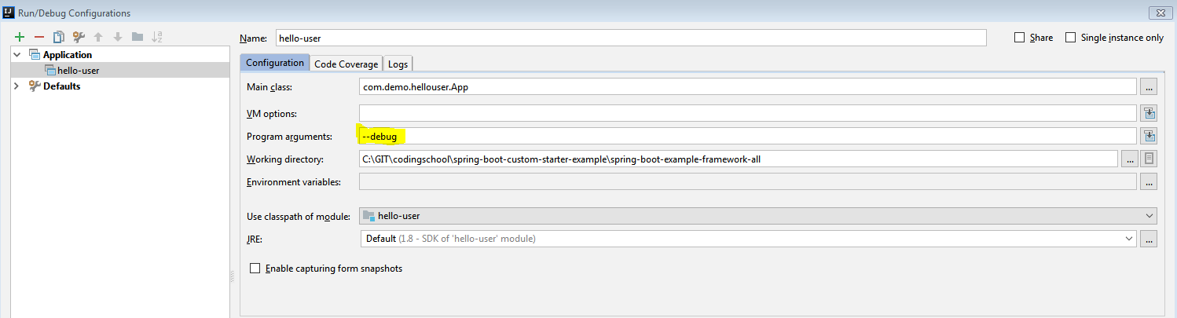
@EnableAutoConfiguration - debug
Start your application with the --debug switch. Doing so enables debug logs for a selection of core loggers and logs a conditions report to the console.

Slide 13
@EnableAutoConfiguration in spring-boot
Browse the source code of spring-boot-autoconfigure to see the @Configuration classes that Spring provides.
https://github.com/spring-projects/spring-boot/blob/v2.0.0.RELEASE/spring-boot-project/spring-boot-autoconfigure/src/main/resources/META-INF/spring.factories

Slide 14
@EnableAutoConfiguration - Exclude
You can always manually exclude() any configuration that you never want to apply.
@EnableAutoConfiguration(exclude = HelloServiceConfig.class)
Or
@EnableAutoConfiguration(excludeName = "com.demo.hellostarter.config.HelloServiceConfig")

